Slide 2

Image Style Transfer using Convolutional Neuron Network
Name: Nguyen Van Kiet – 20224286
Vu Minh Phuong – 20224290
Instructor: Assoc.Prof. Tran Thi Thanh Hai
Assoc.Prof. Le Thi Lan
Class: Digital Image Processing

Slide 3
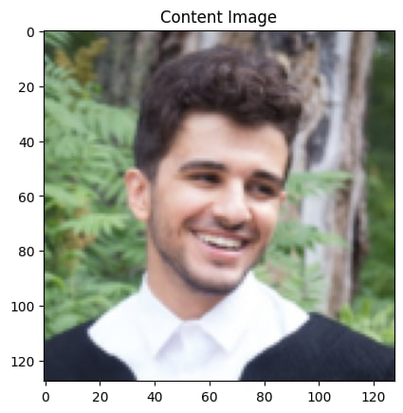
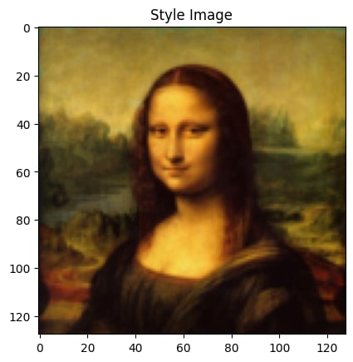
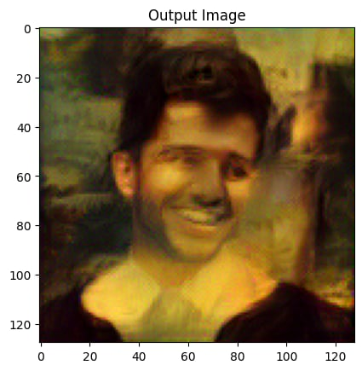
Overview

Slide 4
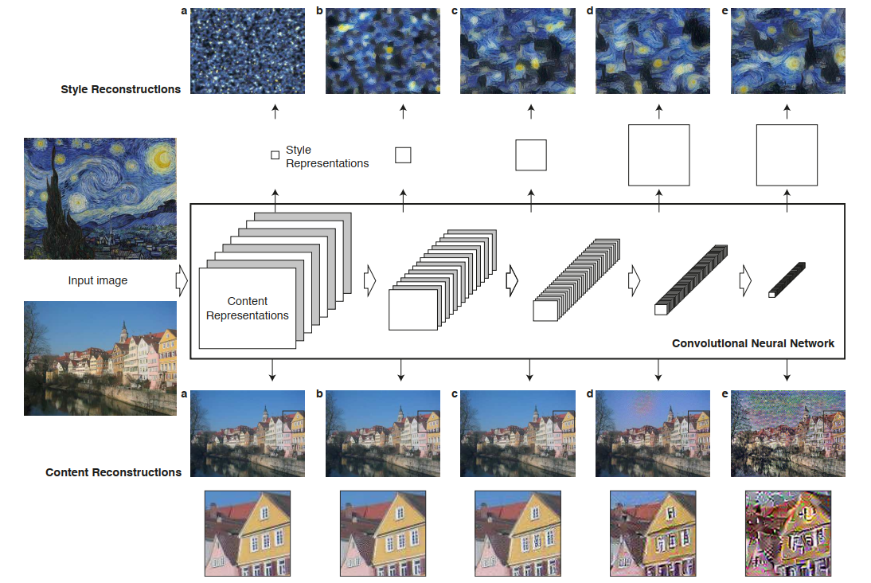
Overview

Slide 5
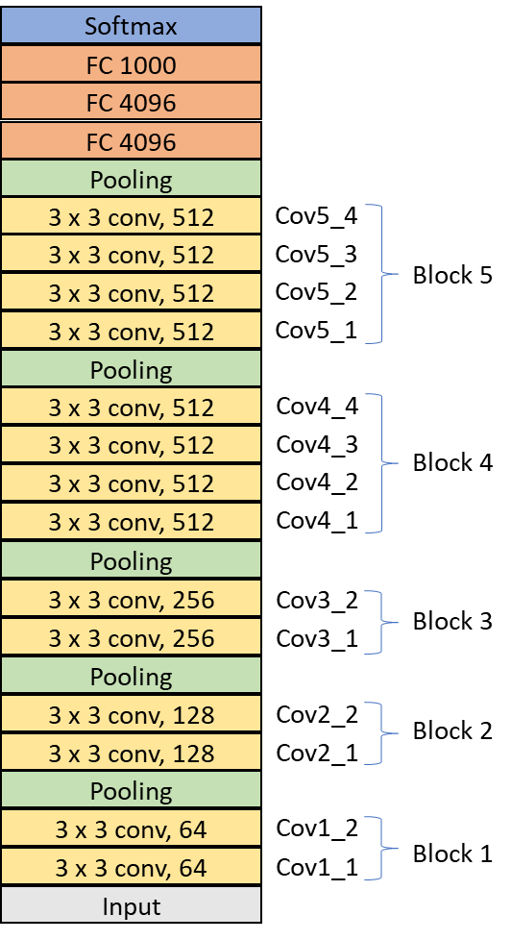
I. Method
VGG 19
A pre-trained convolutional neural network (CNN) designed for image classification, adapted for feature extraction.
Why VGG-19? It captures both low-level (edges, textures) and high-level (shapes, objects) features effectively.

Slide 6
I. Method
- Early layers (e.g., conv1_1, conv2_1) capture fine details like textures and edges

Slide 7
I. Method
- Early layers (e.g., conv1_1, conv2_1) capture fine details like textures and edges
- Deeper layers (e.g., conv4_2, conv5_1) capture higher-level content information, such as object shapes and structure.

Slide 8
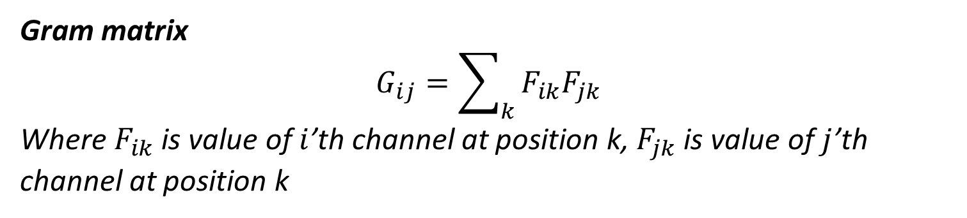
I. Method
Content Loss: Measures the difference between the feature map of the content image and the generated image at a particular layer of the CNN.
Style Loss: Measures the difference in the gram matrix (a statistical representation of feature maps) between the style image and the generated image. The gram matrix captures the correlations between different features, which is key to preserving the artistic style.
Gram matrix
$$G_{ij}=\sum_{k}{F_{ik}F_{jk}}$$
Where $F_{ik}$ is value of $i$’th channel at position k, $F_{jk}$ is value of $j$’th channel at position k

Slide 9

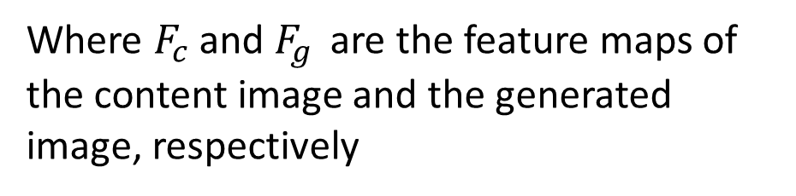


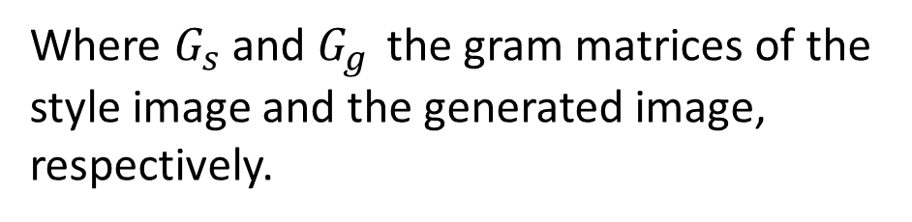
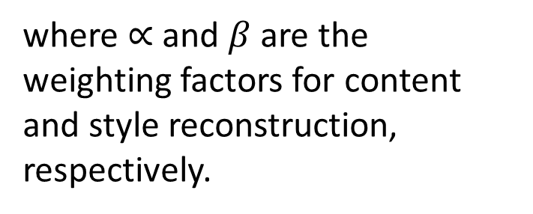
I. Method
Loss Functions
Content loss
$$L_{content}={\left\|F_{c}−F_{g}\right\|}^{2}$$
Loss function
Where $F_{c}$ and $F_{g }$ are the feature maps of the content image and the generated image, respectively
$$L=∝L_{content}+βL_{style}$$
Style loss
where $∝$and $β$are the weighting factors for content and style reconstruction, respectively.
$$L_{style}={\left\|G_{s}−G_{g}\right\|}^{2}$$
Where $G_{s}$ and $G_{g }$ the gram matrices of the style image and the generated image, respectively.

Slide 10
I. Method
Optimization: use the LBFGS optimizer (This optimizer iteratively adjusts the pixels of the generated image to minimize the total loss.
The optimization process:
Forward Pass: compute the content and style losses.
Backward Pass: the gradients of the loss are computed, and the optimizer adjusts the image to reduce the loss.
Update Image: the optimizer updates the generated image in each iteration, and the process repeats until the total loss converges.

Slide 11
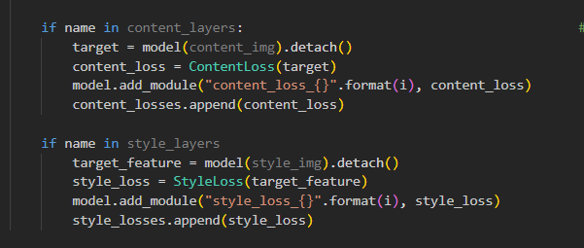
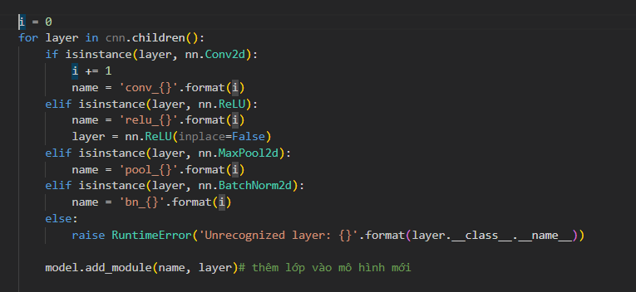
II. Build model base VGG19 v

Slide 12
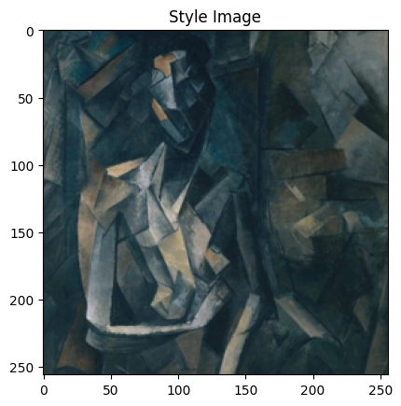
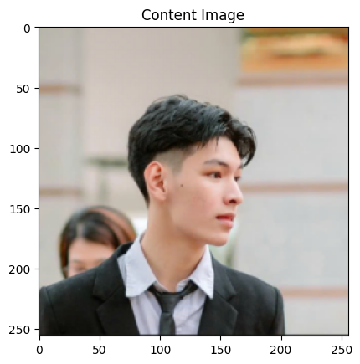
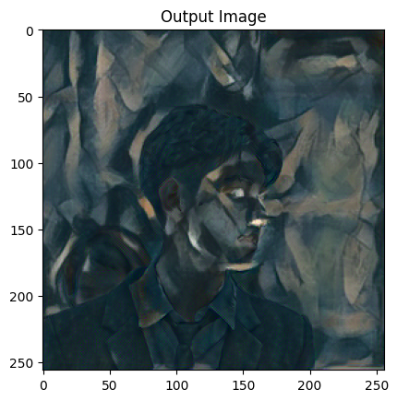
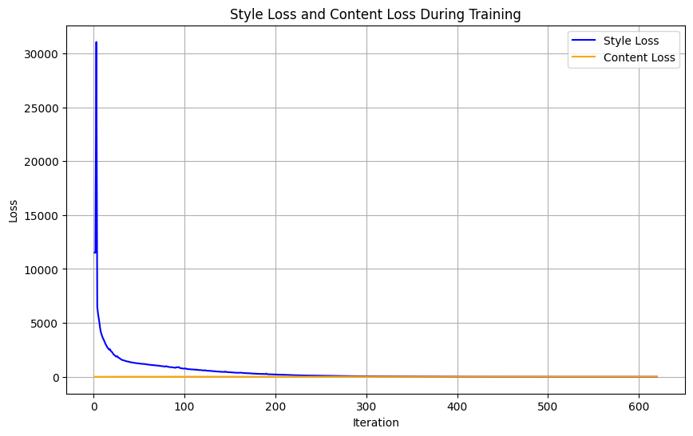
IIi.Result

Slide 13
IV. Challenges
High Computational Cost: Requires GPUs for real-time applications.
Temporal Consistency: Difficult to apply consistently across video frames.
Style Generalization: Models struggle with entirely new styles or complex input.

Slide 14
V. Reference
- Neural Style Transfer : From Theory to Pytorch Implementation:
https://www.youtube.com/watch?v=c3kL9yFGUOY&t=2289s
Paper : Image Style Transfer Using Convolutional Neural Networks
(Leon A. Gatys, Alexander S. Ecker, Matthias Bethge )
- Github code: https://github.com/yacineMahdid/artificial-intelligence-and-machine-learning/tree/master/Neural%20Style%20Transfer%20(Original%20Version

Slide 15
THANK YOU !

Slide 17
